Slide 1

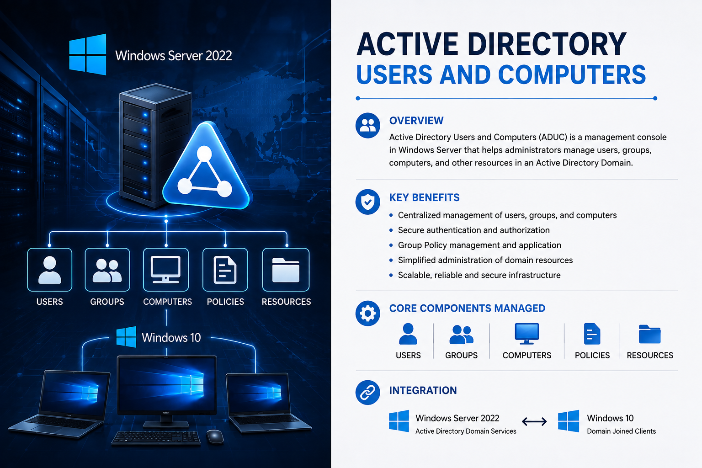
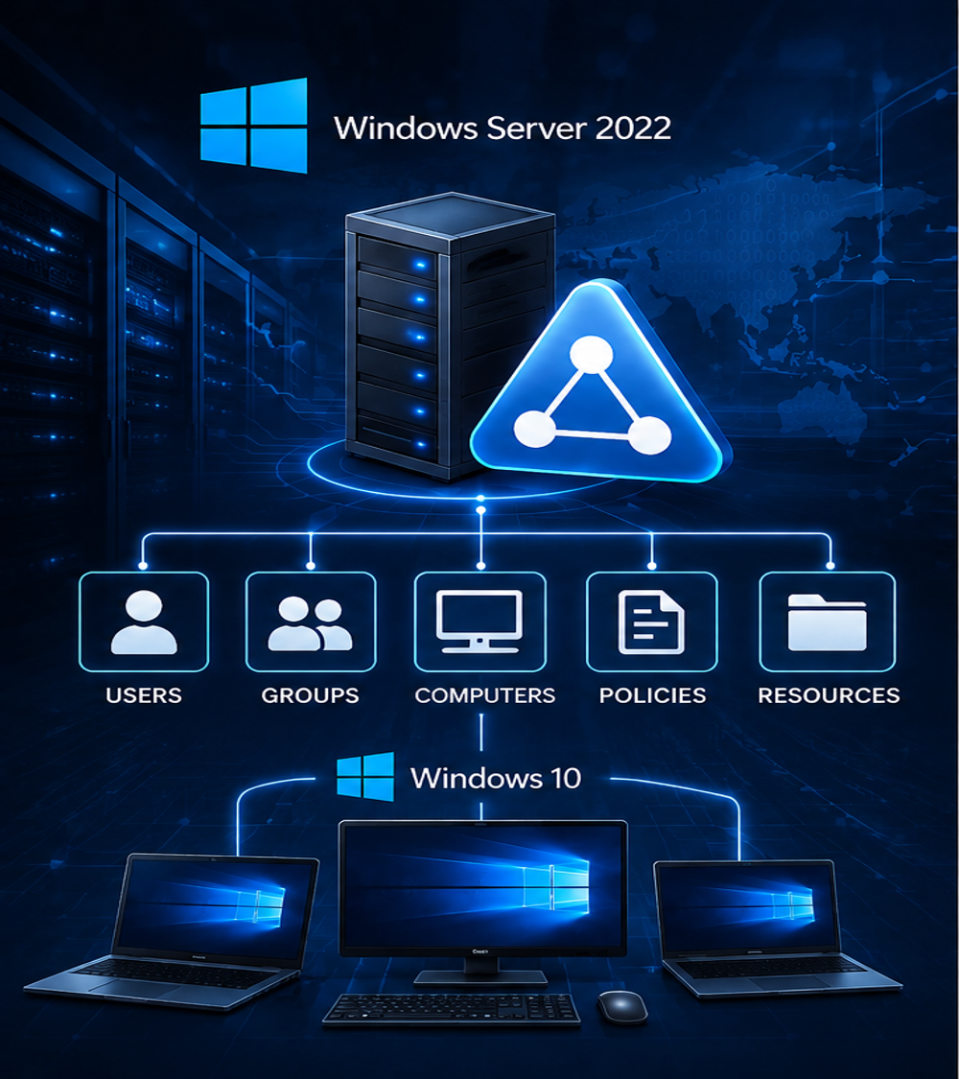
ACTIVE DIRECTORY USERS AND COMPUTERS
ACTIVE DIRECTORY USERS AND COMPUTERS
Industrial Training Project Presentation
PREPARED BY
EKAMPREET SINGH
Bachelor of Technology
(Computer Science & Engineering)
Cybersecurity
SUBMITTED TO
Mr. Manpreet Singh
GUIDED BY
Mr. Khushdeep Singh

Slide 2
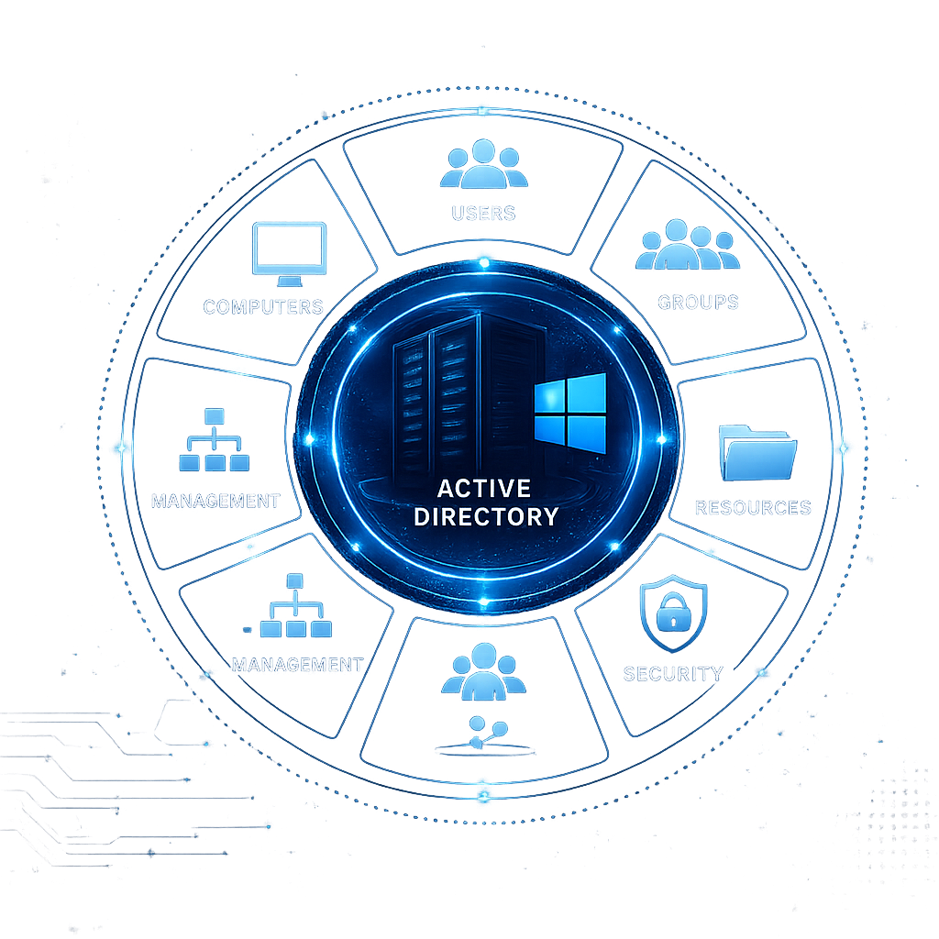
ACTIVE DIRECTORY USERS AND COMPUTERS
• Active Directory (AD) is a directory
service developed by Microsoft
for Windows Server.
• It provides centralized management
of users, computers, groups, and
network resources.
INTRODUCTION

Slide 3
ACTIVE DIRECTORY USERS AND COMPUTERS
WHAT IS ACTIVE DIRECTORY?
Active Directory (AD) is Microsoft's directory service
that stores information about users, computers, printers,
groups, and other network resources in a centralized
database.
It authenticates users, authorizes access to resources,
and allows administrators to manage the entire network
from a single location.
Active Directory uses a hierarchical structure
consisting of Domains, Organizational Units (OUs),
Users, Groups, and Computers to organize network
resources efficiently.
Active Directory
Users
Groups
Computers
OUs

Slide 4
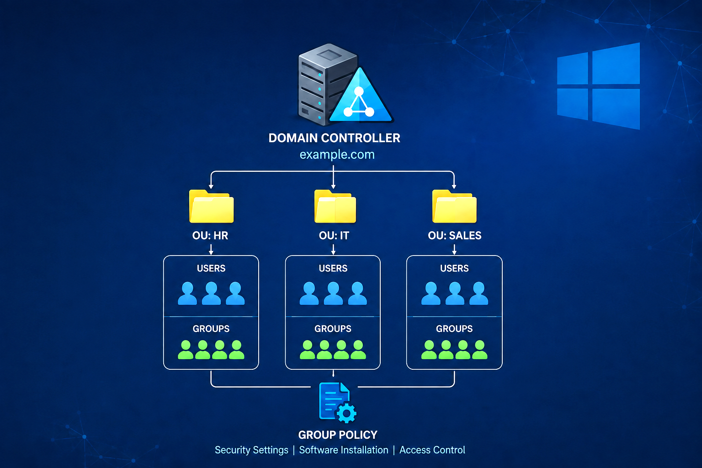




ACTIVE DIRECTORY USERS AND COMPUTERS
FEATURES OF
ACTIVE DIRECTORY
CENTRALIZED MANAGEMENT
Manage all users, computers and resources from a single location.
AUTHENTICATION & AUTHORIZATION
Provides secure authentication and controls access to resources.
GROUP POLICY MANAGEMENT
Enforce policies and configurations across users and computers.
SCALABILITY
Easily scales to support small businesses to large enterprises.

Slide 5
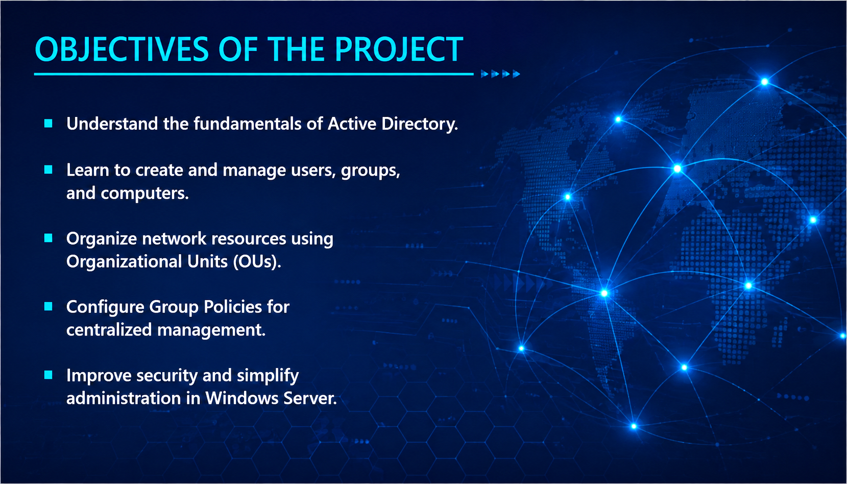
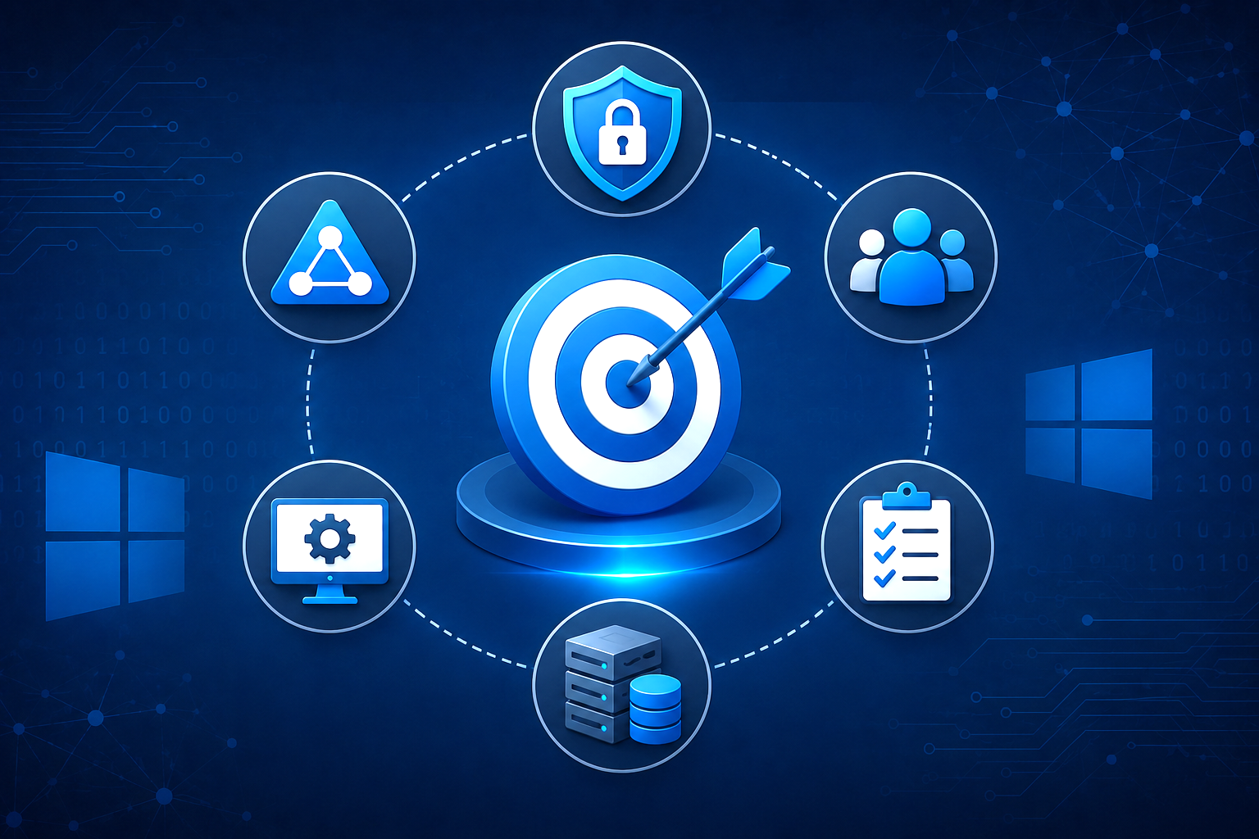
ACTIVE DIRECTORY USERS AND COMPUTERS
OBJECTIVES OF THE PROJECT
Understand the fundamentals of Active Directory.
Learn to create and manage users, groups, and computers.
Organize network resources using Organizational Units (OUs).
Configure Group Policies for centralized
management.
Improve security and simplify administration in Windows Server.

Slide 6
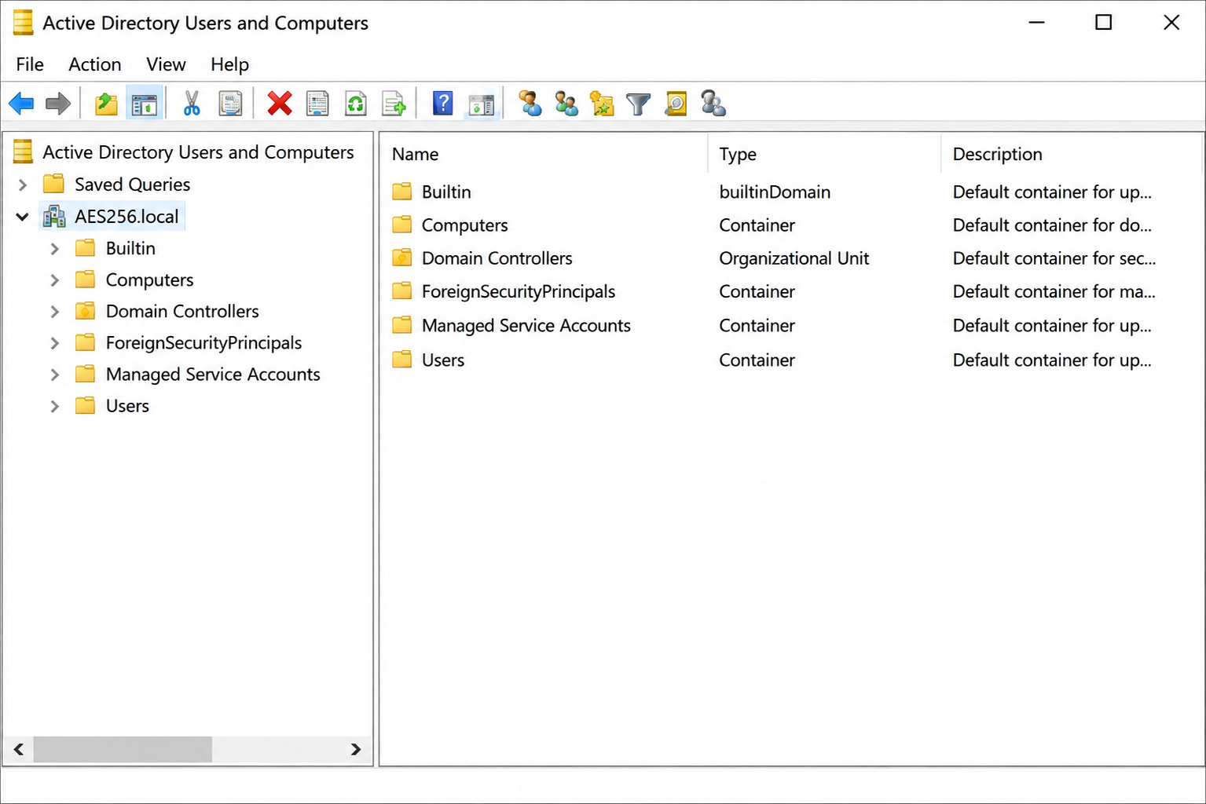
ACTIVE DIRECTORY USERS AND COMPUTERS
ACTIVE DIRECTORY USERS AND COMPUTERS (ADUC) INTERFACE
⚙️Interface Overview
Navigation Pane – Displays the domain and organizational structure.
Details Pane – Shows users, groups, computers, and OUs.
Toolbar – Provides quick access to common administrative tasks.
Menu Bar – Contains management and configuration options.
Domain Tree – Organizes Active Directory objects hierarchically.

Slide 7
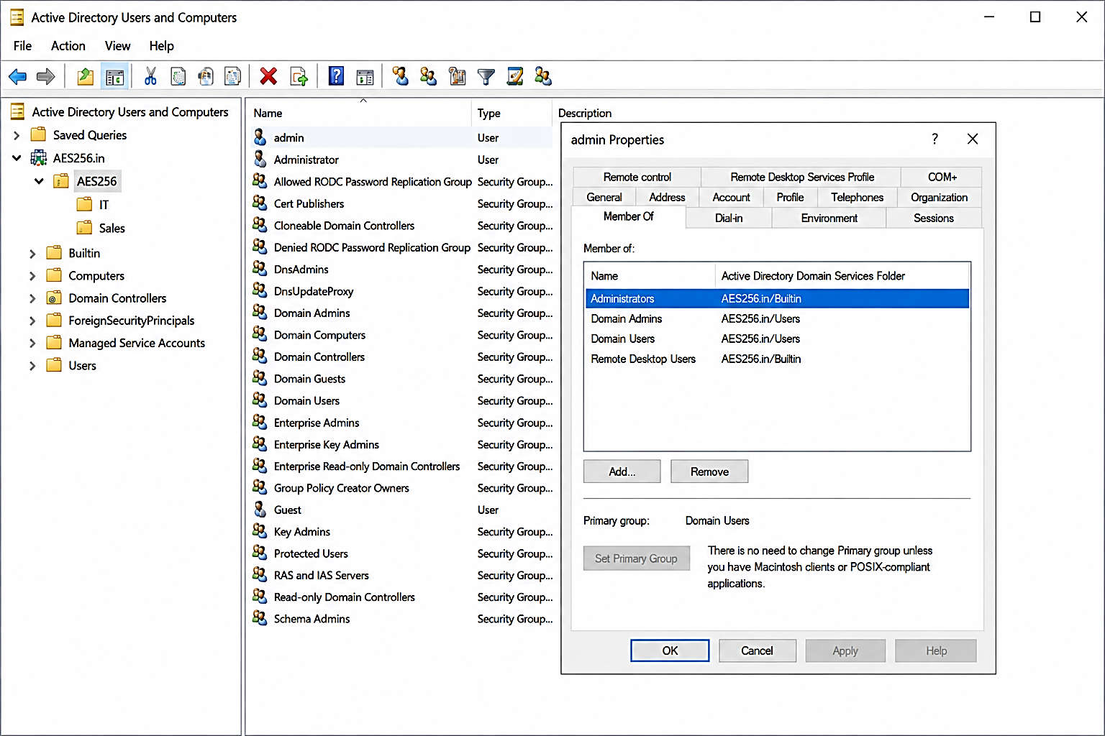
ACTIVE DIRECTORY USERS AND COMPUTERS
CREATING AND MANAGING USERS & GROUPS
👤User Management Process
Create a New User
Assign User Properties
Add User to Groups
Configure Password Policy
Verify User Login
Successfully Created Domain User (Member1) in the IT Organizational Unit (OU)

Slide 8
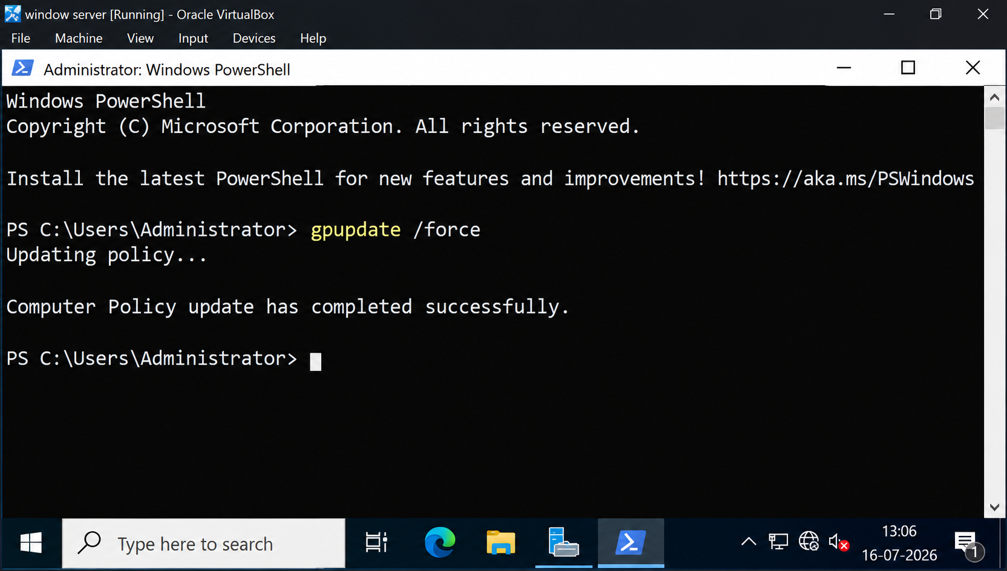
ACTIVE DIRECTORY USERS AND COMPUTERS
GROUP POLICY MANAGEMENT
What is Group Policy?
Group Policy allows administrators to centrally configure and enforce settings for users and computers within a Windows domain.
Key Functions
Security Settings – Enforce password and security policies.
User Configuration – Control user-specific settings.
Computer Configuration – Manage computer settings.
Centralized Control – Apply policies across the domain.
Group Policy Updated Successfully

Slide 9
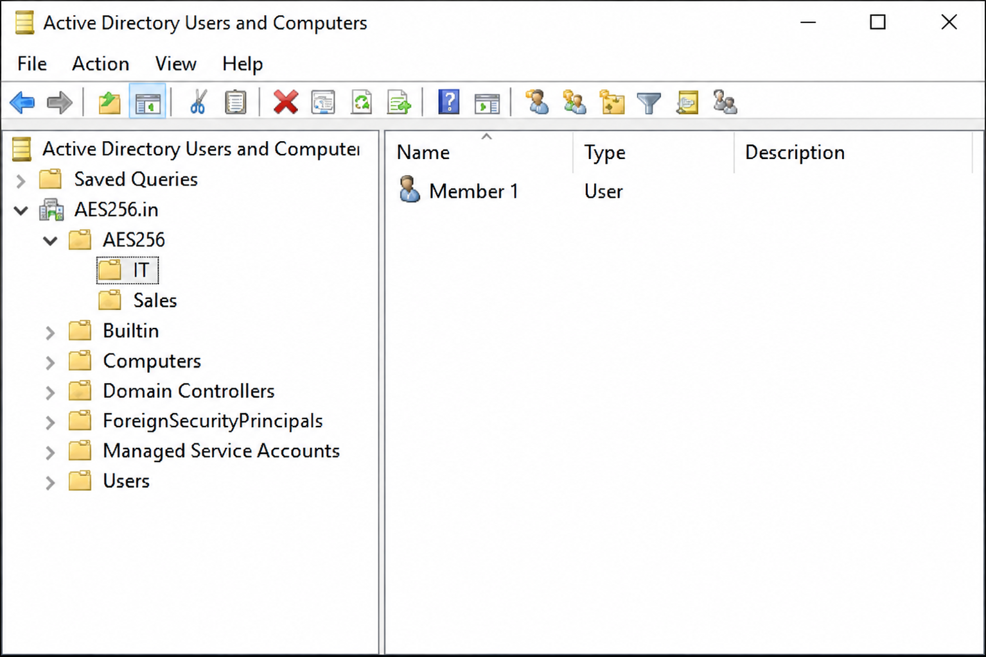
ACTIVE DIRECTORY USERS AND COMPUTERS
ORGANIZATIONAL UNITS (OUs)
Purpose of Organizational Units
Organizational Units (OUs) provide a structured way to organize and manage users, computers, and groups within a domain.
How OUs Help
Organization – Groups related users and computers.
Delegation – Allows administrators to manage specific OUs.
Policy Management – Applies Group Policies to selected objects.
Simplified Administration – Makes large domains easier to manage.

Slide 10
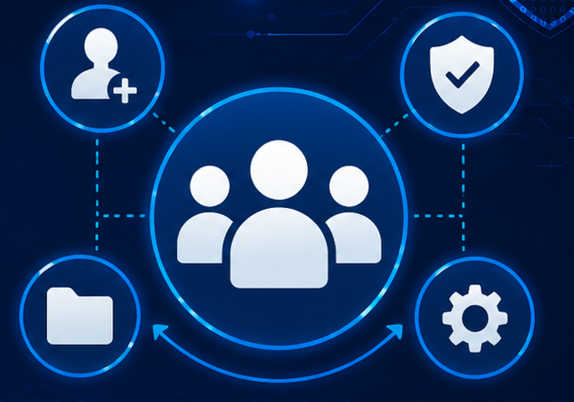
ACTIVE DIRECTORY USERS AND COMPUTERS
GROUP MANAGEMENT
Group Management Process
Create Groups — Create security or distribution groups.
Add Members — Assign users to appropriate groups.
Manage Permissions — Control access to domain resources.
Review Membership — Verify users and their assigned groups.
Group Membership
Users can be added to security groups to receive the permissions and access required for their roles.

Slide 11
ACTIVE DIRECTORY USERS AND COMPUTERS
SECURITY & ACCESS CONTROL
🔐 User Authentication
Verify user identity before granting access to domain resources.
📂
👥
🛡️
🛡️ Group-Based Permissions
Assign permissions through security groups.
🔒
⚠️ Account Protection
Disable or remove unnecessary accounts promptly.
🔑
🚫 Least Privilege
Give users only the access required for their roles.

Slide 12
ACTIVE DIRECTORY USERS AND COMPUTERS
ACTIVE DIRECTORY REUIRED TOOLS
🖥️ WINDOWS SERVER 2022
Domain Controller - Hosts Active Directory servicesand manages the domain.
💻 Windows 10
Client operating system used to test domain connectivity and user access.
📂 Active Directory Users Computers
Administration tool used to manage users, groups, computers, and Ous.
⚙️ Group Policy Management
Used to configure and enforce policies across the domain.
📦 Oracle VirtualBox
Virtualization platform used to create the Windows Server and client lab.

Slide 13

ACTIVE DIRECTORY USERS AND COMPUTERS
Thank you

